Slide 1


We Make
Health Happen
The eight week ‘novi experience’ campaign
Diabetes Care
Weight Care
Metabolic Start
Health Assessment and Longevity

Slide 2

In a world obsessed with "quick fix" weight loss drugs, or longevity hacks NOVI is proving, through peer-reviewed science, that the Human + Tech + Medical triad delivers real lasting results, this campaign builds the why - behind the how.
The Objective.
To solidify NOVI Health as the authoritative leader in metabolic health in Singapore by leveraging new clinical data and launching the "NOVI Experience" 2 month campaign

Slide 3
‹#›
Narrative Plan.
APRIL
MAY
“Kickstart your metabolism”
“The NOVI experience”
A science-backed reset, grounded in real clinical outcomes and supported by our publication in the International Journal of Obesity. Designed to help you understand, optimise and take control of your metabolism with clarity and confidence.
A look behind the curtain of our “Human + Tech” model — where clinical expertise meets data-driven care. Through insider content and behind-the-scenes access, we shift the focus to the provider journey: how our doctors, coaches and systems work together to deliver outcomes.
This is brought to life through “day in the life” storytelling and deeper dives into the thinking behind our approach, supported by the launch of our Live Well community series — from walks and HIIT to matcha workshops — extending the NOVI experience beyond the clinic.
Anchored by our Diabetes Journal publication and a new pricing reveal, this month brings together proof, experience and access.
Planning doc is here: https://docs.google.com/document/d/1ZfjdZDw4wQxu4nBhE8R0DryOsUCn7H_ze4ARpJ6SvEs/edit?tab=t.v1hw4lm2bjr4

Slide 4
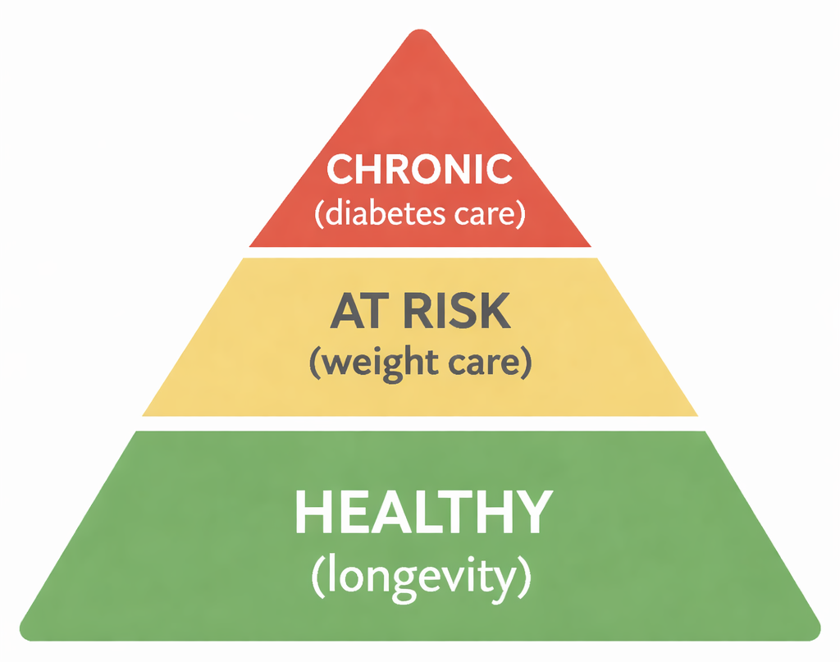
‹#›
The Message Foundation
At NOVI, we don’t treat conditions in isolation. We build, correct & control your health over time.
From optimising energy, to addressing weight & risk, to managing chronic conditions like diabetes.
It’s one connected journey; that journey is longevity.
Longevity isn’t about living longer someday.
It’s about living better now, and staying that way.

Slide 5
PURPOSE OF THE SERIES
Bringing the NOVI care model to life
The series is designed to show how we deliver results in the real world — the people, spaces, systems and continuous care that sit behind every patient outcome. It is built to work in lockstep with the Novo Nordisk partnership, the Diabetes publication, and the TBT content collaboration.
Film series
Spotify launch
8 hero films — weekly release from May 21. Each one reveals a different dimension of the NOVI care model.
Channel launches June 4 alongside FAQ Episode 1. Extends NOVI's audio presence.
Ask The Doctor / Coach / AMA
Website relaunch
AMA series with pre-seeded questions. EDM (W1) → Record (W2) → Live on IG/YT (W3). Repeatable format.
Late June. Content, editorial and article resurfacing to strengthen SEO and site authority.
55 Questions & FAQ
Community events
Filmed this week. Episode 1 releases June 4. Quick-format clinical Q&A for social and Spotify.
NOVI Walks (June), Matcha workshops (mid-June), Mandala talks (June 30), Ignite (July).

Slide 6
RELEASE SCHEDULE — MAY 21 TO MID-JULY 2026
8 weeks, 8 themes, building to Ignite
Asset
W1 21 May
W2 28 May
W3 4 Jun
W4 11 Jun
W5 18 Jun
W6 25 Jun
W7 2 Jul
W8 9 Jul
Hero film
W1
W2
W3
W4
W5
W6
W7
W8
Ask Dr Whitney
EDM
Rec
Release
76Q FAQ / Spotify
Launch
IG: video + carousel
●
●
●
●
●
●
●
●
EDM broadcast
●
●
●
●
●
●
●
●
WhatsApp blast
●
●
●
●
●
●
●
●
Articles / PR
Novo PR 26/27
Obesity art
Diabetes
CNA
BT Art 1
PR drop
Novo blog
Community events
Walks
Ignite
Matcha

Slide 7
CONTENT ECOSYSTEM
Articles · podcasts · events · social — all in lockstep
Film series (IG/YT/LI)
Instagram
EDM + WhatsApp
Weekly hero film
seeds each theme
1 video + 1 carousel
per week
Anchor message
+ community broadcast
AMA
Articles + SEO
Community events
EDM seed → Record
→ IG/YT release (W3)
Blog, BT advertorials,
CNA, press releases
Walks, workshops,
Dialogue, Ignite
All channels carry the same weekly theme. Each asset compounds the one before it. Ignite is where it all converges.

Slide 8
SPECIAL FORMAT
AMA - doctor / coach series, kick off
A recurring, high-trust format that positions NOVI's clinical team as approachable experts. Built around real questions from real patients and prospects — seeded via EDM to build participation before filming.
Week 1
28– May
Week 2
1 Jun
Week 3
8 Jun
EDM seed
Record
Release
Send to full list. Subject: 'Ask our doctor anything.' Invite community to submit health questions. Pre-seeded Qs in the EDM to prompt participation. Link to question submission form or WhatsApp broadcast.
Film Dr Whitney answering top questions. Studio quality. 8–12 questions per session. Short-answer format (30–90 sec per Q). Record enough for multiple releases. Think: Vogue 73 Questions energy — warm, confident, clinical.
Episode 1 goes live on IG Reels and YouTube. Cut into individual Q clips for Stories and Shorts. One hero cut (3–5 min) for YT. Each clip ends with soft CTA. Runs alongside Spotify launch and FAQ Episode 1 for maximum W3 impact.
Format is repeatable — Dr / coaches session becomes a monthly series. Each release extends NOVI's content library with zero ongoing production cost once templated.

Slide 9
W1 · 21–25 May
This is what care looks like
ACQUISITION HOOK
What does a health clinic actually do between your appointments? This week, we show you.
RELEASING THIS WEEK
Hero film 1: The First 10 Minutes
Novo Nordisk press release
Novo EDM + landing page
Ask Dr Whitney EDM seed
HERO FILM
INSTAGRAM
EDM
The First 10 Minutes
Video: Hook (0–3s): A clinician opens a door. No words.
Subject: A new standard in weight care — NOVI and Novo Nordisk — Lead with patient-centric language. Announce partnership. Link to landing page. Warm, clinically credible. Not a product push — a belief statement about access and supported care.
Cinematic walk-through of a patient's first NOVI appointment. Clinic space, clinician greeting, first consultation moment. Sound design only. No voiceover.
Carousel: Title: What your first NOVI appointment actually looks like
Caption: What happens in the first 10 minutes of a NOVI appointment? Everything starts here. · CTA: Link in bio → book your first appointment
WHATSAPP
Welcome message to existing patients. Introduce the NOVI WhatsApp Community. Frame it as updates, event invites and real health conversations — not a sales channel.

Slide 10
W2 · 28 May–1 Jun
The science behind the weight - follows NOVO PR
ACQUISITION HOOK
You've tried everything. So why hasn't it worked? The answer isn't discipline — it's biology.
RELEASING THIS WEEK
Hero film 2: A Day in the Life (Health Coach)
Article: What the obesity study actually means for you
Ask Dr Whitney — recording session
HERO FILM
INSTAGRAM
EDM
A Day in the Life — Health Coach
Video: Hook (0–3s): Text card — 'It's not about willpower.'
Subject: What the obesity research actually means for you — Sue-Anne authored 600w piece. Frame the science plainly. Link to blog. End with soft CTA: talk to a NOVI clinician.
Follow a NOVI health coach through a real working day. Coaching calls, case review, end-of-day reflection. Humanises the continuous care model. Cut for IG Reels and YouTube Shorts. Adapts for paid.
Carousel: Title: Why weight isn't a willpower problem
Caption: Weight gain is a medical signal. Your biology is working against you — and that's not your fault. · CTA: Read the full article — link in bio
WHATSAPP
Broadcast: Share the blog article. One line intro from Sue-Anne or Kyle. 'This is the science behind what we see in clinic every day.

Slide 11
W3 · 4–8 Jun
The room matters
ACQUISITION HOOK
The environment where you receive care changes the care itself. We designed ours deliberately.
RELEASING THIS WEEK
NOVI Monthly Walks with Avenue on 3 (kick-off)
Hero film 3: The Room Matters
Spotify channel launch
76 Questions FAQ — Episode 1 release
Diabetes/metabolic health SEO article
Ask Dr Whitney — Episode 1 on IG + YouTube
HERO FILM
INSTAGRAM
EDM
55 Questions with Sue-Anne
Video: Hook (0–3s): Slow pan across clinic. No narration — just space and light.
Subject: NOVI is now on Spotify — your health, in your ears — Announce Spotify + Ask Dr Whitney Episode 1 + FAQ series. Light, exciting, accessible tone. Three launches in one week.Plus the monthly walk kick off.
The beginning of a loing term content arc for NOVI focusing on humanising doctors coaches, team and giving a wider ‘peak’ into our world.
Carousel: Title: Why we designed NOVI's spaces the way we did
Caption: The environment where you receive care is part of the care itself. We designed ours accordingly. · CTA: Come and see it. Book at link in bio.
WHATSAPP
The Room Matters
Broadcast: Spotify launch + Ask Dr Whitney Ep 1 + 76Q Episode 1. 'Watch this if you've ever wondered about X. ' Invite community to submit questions for future episodes.
Slow, deliberate shots of the NOVI clinic. Architecture, light, materials. Intercut with a clinician on why environment is part of care. Premium — closer to a design or hospitality brand than a clinic.

Slide 12
W4 · 11–15 Jun
What continuous care actually means
ACQUISITION HOOK
Most clinics see you once a year. We're with you every step in between.
RELEASING THIS WEEK
Hero film 4: The Case Review
Article: What continuous care means (SEO)
Article: How often should you get a health assessment (SEO)
CNA advertorial (mid-June window)
HERO FILM
INSTAGRAM
EDM
The Case Review
Video: Hook (0–3s): A clinician reviews a file. 'This patient hasn't been in for three weeks. Here's what we're doing.'
Subject: Why most health checks stop at detection — Lead with the 'more tests ≠ better health' reframe. Introduce NOVI's longitudinal model. Link to both SEO articles. Mid-funnel EDM — for prospects who've visited but not converted.
Inside a NOVI clinical case review meeting. Physicians, health coaches, data — discussing a patient journey (anonymised). Shows multi-disciplinary depth behind every care pathway. Strong B2B signal. Adapts for paid.
Carousel: Title: What happens between your NOVI appointments
Caption: Your care doesn't stop when you leave the room. · CTA: Learn how NOVI's model works — link in bio
WHATSAPP
Broadcast: Share the 'continuous care' article with a personal note from a NOVI clinician. 'This is what we mean when we say we're different. ' Soft CTA to book or ask a question.

Slide 13
W5 · 18–22 Jun
Between appointments
ACQUISITION HOOK
Real health isn't measured in annual check-ups. It's built in the days between them.
RELEASING THIS WEEK
Hero film 5: Between Appointments
TBT Advertorial 1 — precision health (live ~third week Jun)
Website relaunch content (late Jun window)
Article: Novo Nordisk partnership + blog
HERO FILM
INSTAGRAM
EDM
Between Appointments
Video: Hook (0–3s): A patient checks their phone. '7pm. My coach just replied.'
Subject: Your health doesn't take a day off — neither do we — Patient-perspective EDM. TBT advertorial live this week — link as external validation. CTA to book.
Real moments from patients' lives between NOVI visits — a morning routine, coaching check-in, food log review. Shows the texture of ongoing care. Intimate, real, elevated. Adapts well for paid targeting of lapsed or considering prospects.
Carousel: Title: How NOVI clients describe life between appointments
Caption: Real health is built in the ordinary moments. We show up there too. · CTA: This is what between-appointment care looks like.
WHATSAPP
Broadcast: TBT advertorial is live. Share link. 'NOVI in The Business Times this week — share with someone who might need this.

Slide 14
W6 · 25–29 Jun
Why we built this
ACQUISITION HOOK
Most healthcare systems are built around disease. We built ours around people.
RELEASING THIS WEEK
Hero film 6: Why We Built This
Matcha making workshops
Diabetes research press release
HERO FILM
INSTAGRAM
EDM
Why We Built This
Video: Hook (0–3s): Sue-Anne to camera. 'We kept seeing patients who were doing everything right.'
Subject: Why two doctors decided to build something different — Founder story EDM. Link to the film. Link to community event registration (Mandala talks June 30). Warm, personal, narrative-led. The EDM that builds deepest brand affinity.
Sue-Anne and Kyle to camera. Founders telling the NOVI origin story — why they left traditional medicine, what they saw that others weren't addressing. Authentic, warm, conviction-led. Highest-value acquisition asset. Adapts for paid.
Carousel: Title: The reason NOVI exists
Caption: The origin story. Why two physicians decided to build something different. · CTA: This is why NOVI exists. Link in bio.
WHATSAPP
Broadcast: Announce NOVI Walks + community events. Invite existing patients and network. 'These events are for our community first.

Slide 15
W7 · 2–6 Jul
Not a moment. A system + website relaunch
ACQUISITION HOOK
NOVI isn't a clinic you visit. It's a system you belong to.
RELEASING THIS WEEK
Hero film 7: Not a Moment. A System. (hero film)
Mandala talks June 30 — follow-up content
Website launch
HERO FILM
INSTAGRAM
EDM
Not a Moment. A System. — Hero film
Video: Hook (0–3s): Fast-cut montage of all previous films. Then: silence. NOVI mark.
Subject: This is NOVI — watch our story — Hero film release. 'This is what we've been building.' Link to full film on YouTube. Pre-Ignite prime — send to full list. High-production feel. CTA: attend Ignite or book a consultation.
The campaign centrepiece. Cinematic edit weaving all previous films — appointments, coach, case review, spaces, founders, patients. 90-second manifesto film for NOVI's full care model. Anchor asset for Ignite. Adapts for paid at multiple lengths.
Carousel: Title: Six things that make NOVI's model different
Caption: This is the film we've been building towards. 90 seconds. The full NOVI story. · CTA: Watch the full film — link in bio. Share with someone who should know about NOVI.
WHATSAPP
The Website
Broadcast: Hero film drop. 'Exclusive preview for our WhatsApp community before public release. ' Create shareable moment — 'Share this with someone who should know about NOVI.
Mini video for social tak-over walking the new website, changes look and feel and how to navigate

Slide 16
W8 · 9–13 Jul
Welcome to NOVI — Ignite week
ACQUISITION HOOK
Every system starts with a single decision. Are you ready to make yours?
RELEASING THIS WEEK
Hero film 8: Welcome to NOVI (POV journey)
Ignite event — all campaign activity converges here
HERO FILM
INSTAGRAM
EDM
Welcome to NOVI — POV Journey
Video: Hook (0–3s): POV — a hand on a door handle. It opens.
Subject: NOVI Ignite — you're invited — Event invitation EDM. Full Ignite programme. RSVP link. Hero film embedded. The campaign's commercial moment — every prior week has been building to this. CTA: register for Ignite or book a consultation.
First-person POV film. The camera is the new patient. We walk into the clinic, meet the team, sit in the first consultation, see the results, leave with a plan. Immersive, intimate, minimal narration. Designed to make the viewer feel what a NOVI patient feels. Strongest conversion video of the series.
Carousel: Title: What your first NOVI experience looks like
Caption: This is what your first NOVI appointment feels like — from the inside. Welcome. · CTA: Book your first appointment — link in bio. Or join us at Ignite.
WHATSAPP
Final broadcast: Ignite invitation. 'Our community gets first access. ' Event details + RSVP link.

Slide 17
INSTAGRAM — MASTER BRIEF
One video + one carousel, every week
Video / Reels format
Hook in 0–3 seconds — no exception. Aspirational, premium, elevated. No text-heavy openers. Let the visuals earn the watch time. Always end with one clear CTA. Designed for sound-on but watchable sound-off.
The First 10 Minutes
Coaching — also adapted for ads
The Room Matters
The Case Review — also adapted for ads
Between Appointments
Why We Built This — also adapted for ads
Not a Moment. A System. (Hero Film) — also adapted for ads
Welcome to NOVI (POV Journey) — also adapted for ads
Carousel format
Slide 1 is the hook — it must earn the swipe. Every slide advances the thought. Slide 5 or 6 is always the CTA. Write for someone who will screenshot individual slides. Make each one standalone-worthy.
Paid adaptation
Films 2, 4, 6, 7, 8 are flagged as paid-ready. Crop to 1:1 and 9:16. Add CTA overlay for paid versions. Target: existing followers (retention), lookalike audiences (acquisition), retargeting website visitors (conversion).
Caption tone
Aspirational and premium. Intelligent but accessible. No emojis unless intentional. One key message per caption. Short first line that earns the 'more' tap. Always ends with a CTA or genuine question.

Slide 18
WHATSAPP COMMUNITY — PLAYBOOK
Build a community, not a broadcast list - Naomi
Phase 1: Seed (W1–W2)
Phase 2: Grow (W3–W5)
Invite existing NOVI patients first — highest trust, highest engagement
Invite event attendees after each community event
Personal message from Tempest or a clinician, not a mass blast
Add warm EDM leads who have clicked but not booked
Welcome message pinned: 'Real conversations about health — updates, events and things we think you'll find useful'
Exclusive early access to all events announced here first — trains community to stay subscribed
WhatsApp Channel (broadcast) for announcements; WhatsApp Group for event attendees only
Monthly Q&A window: 24hrs open for questions, Sue-Anne or Kyle answers on video
Weekly cadence (every week)
Rules for the team
Monday: weekly theme broadcast — 3 sentences max, one link always
Never use the community to chase bookings — it breaks trust permanently
Same-day video drop: share the week's film with one line of context
Always acknowledge replies in the community group — even a reaction counts
48hrs before any event: reminder with RSVP link
Events get exclusive access before any other channel — every time
One message per day maximum — more than one = unsubscribes
Keep the tone warm and human — this is not a marketing channel

Slide 19
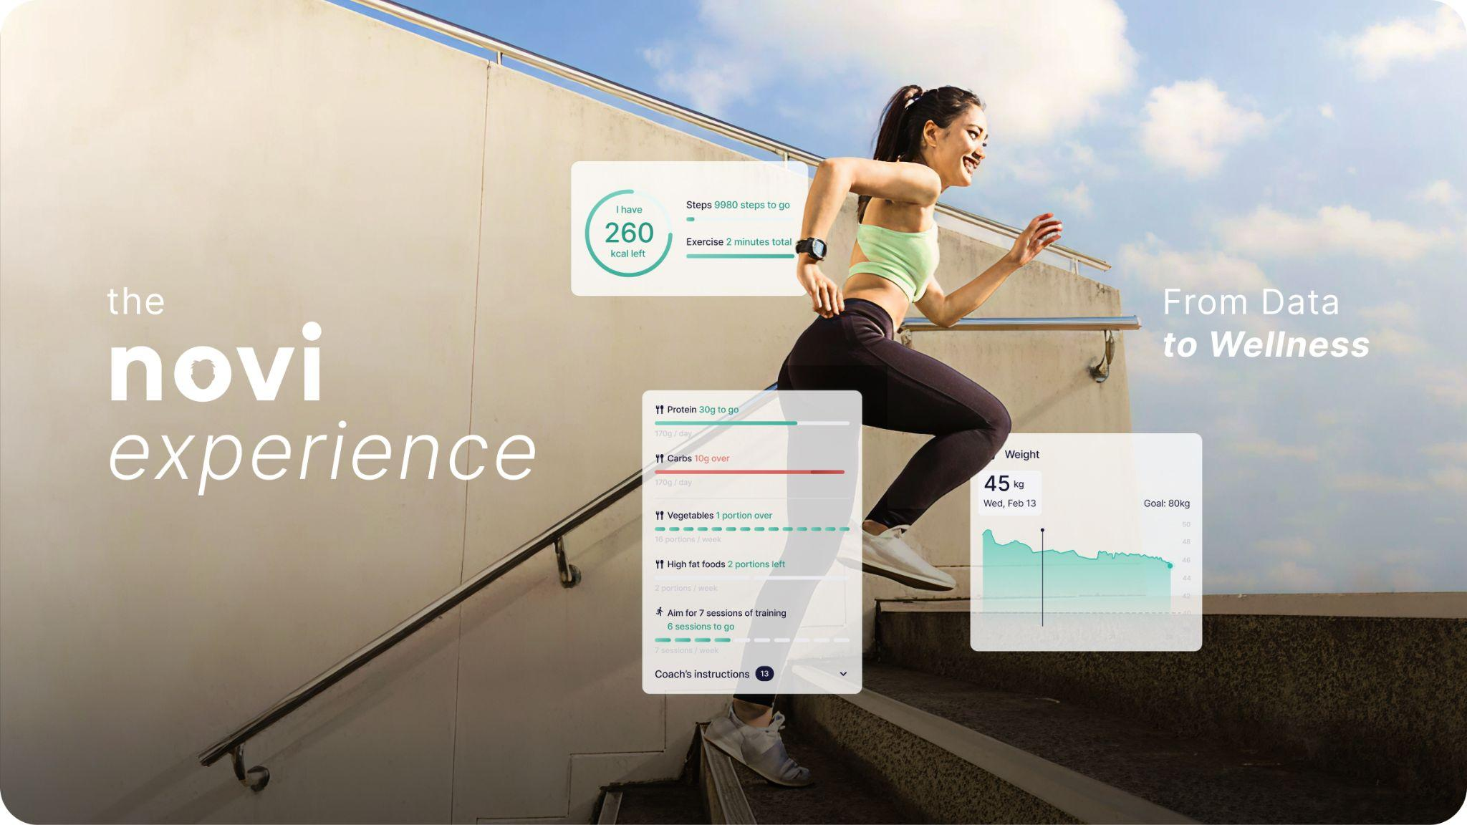
The NOVI Experience: Visual Wrap
‹#›

Slide 20
The NOVI Experience: Visual Wrap
‹#›

Slide 21
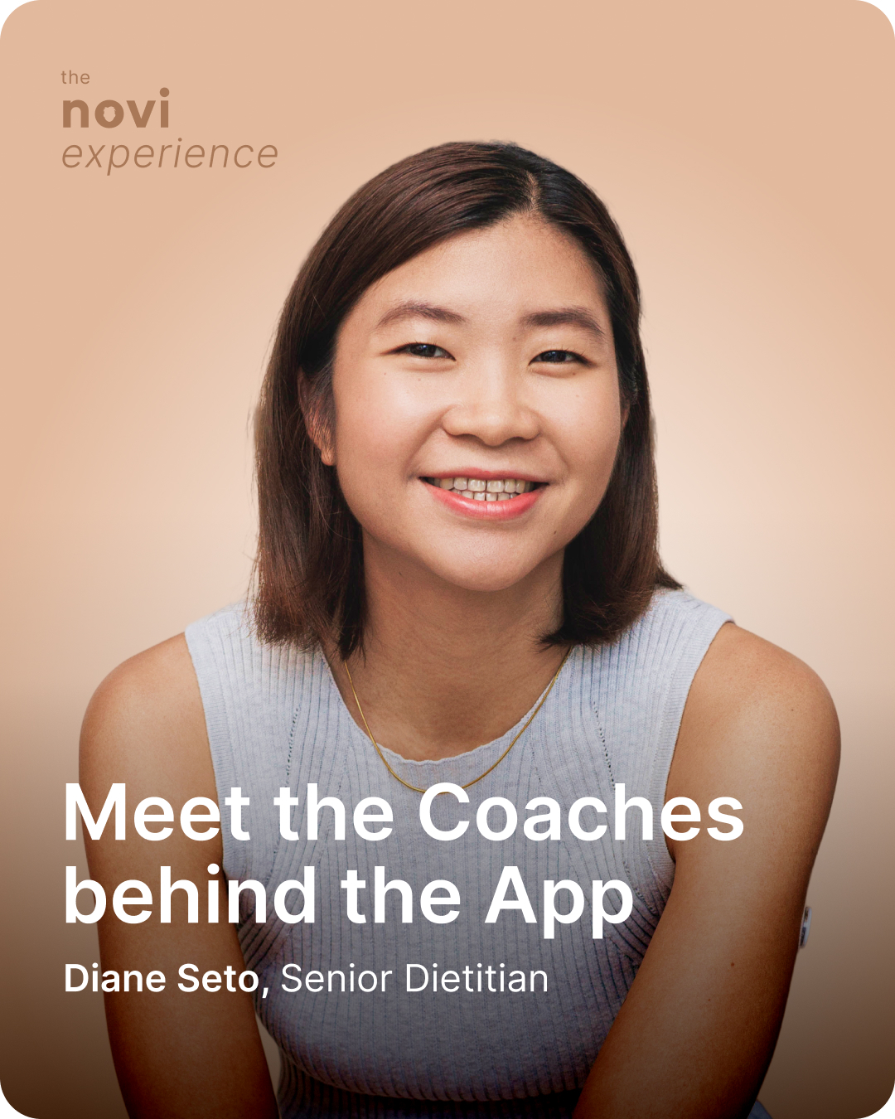
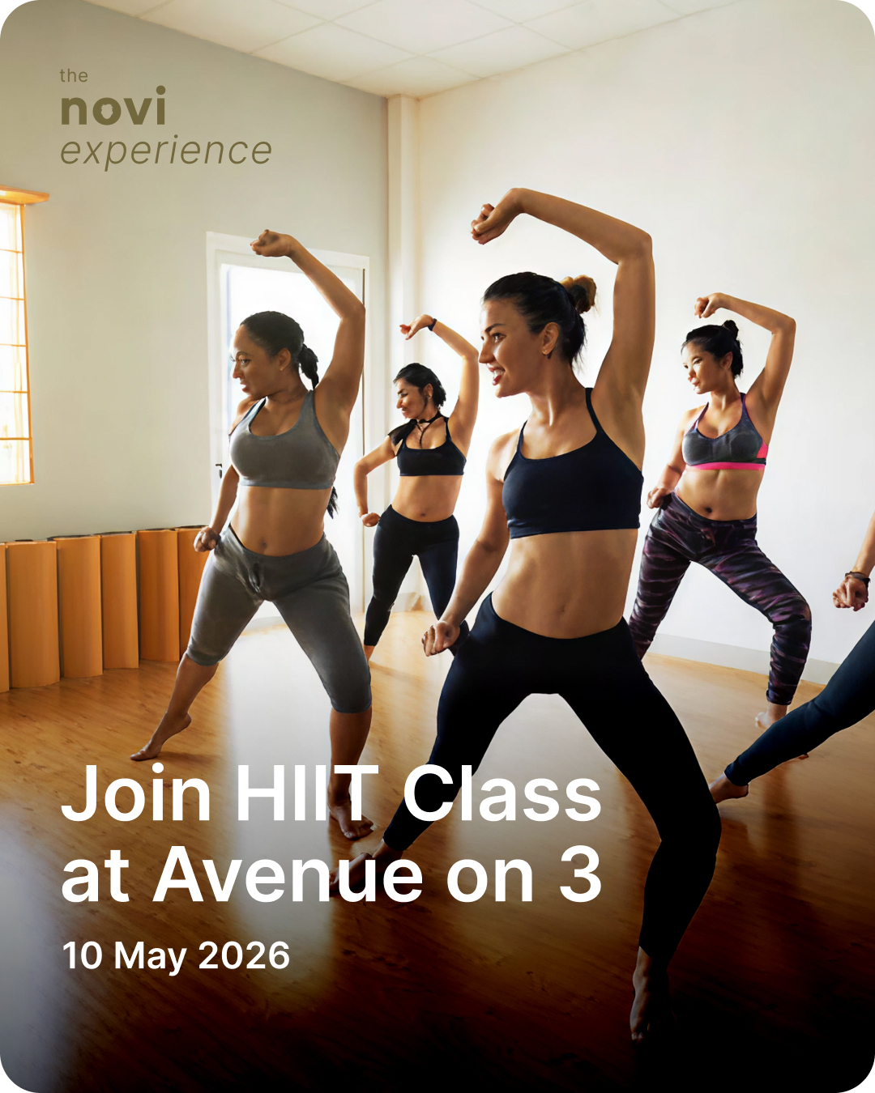
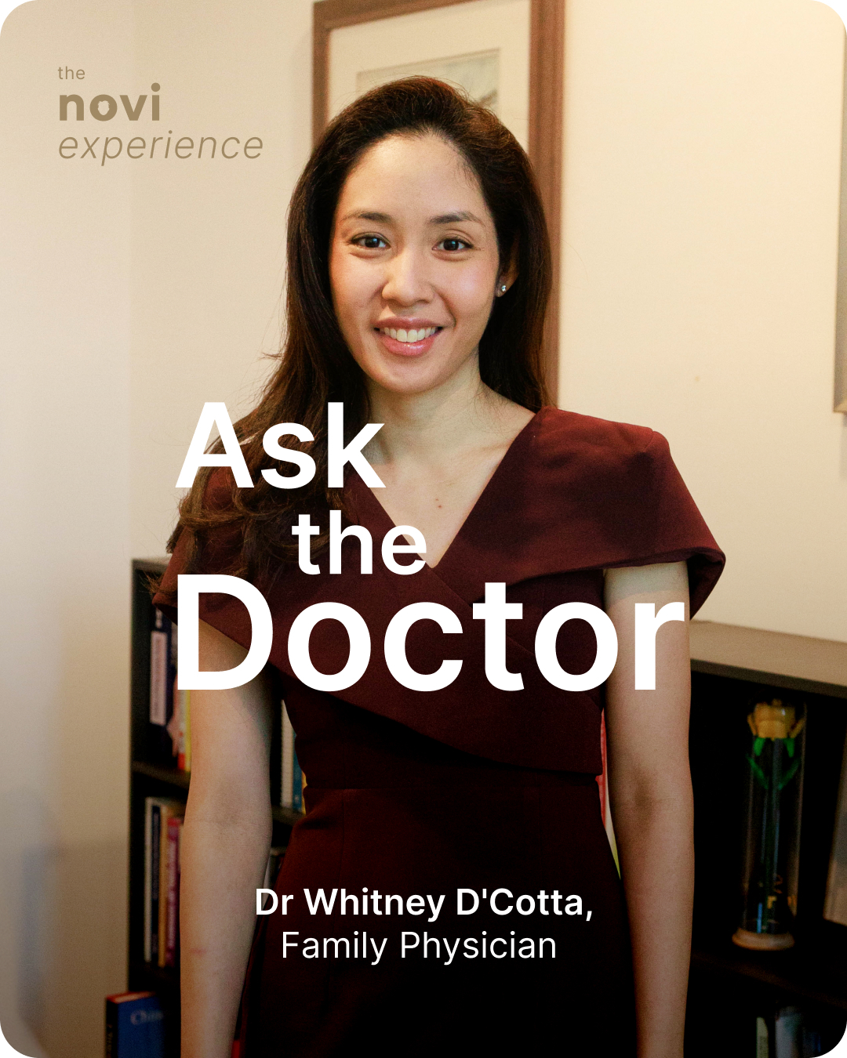
‹#›
The NOVI Experience: Community + Humanising NOVI

Slide 22
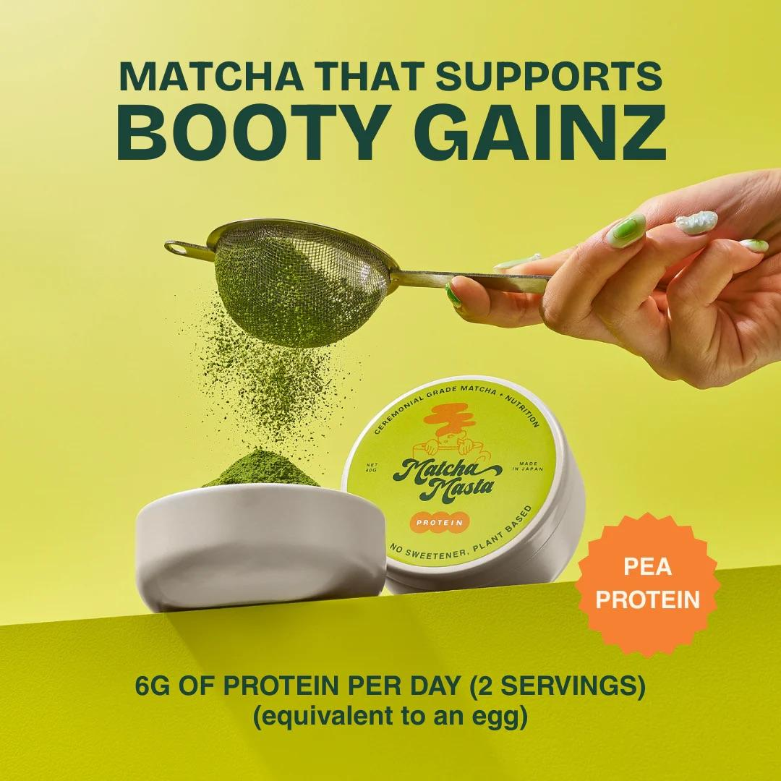
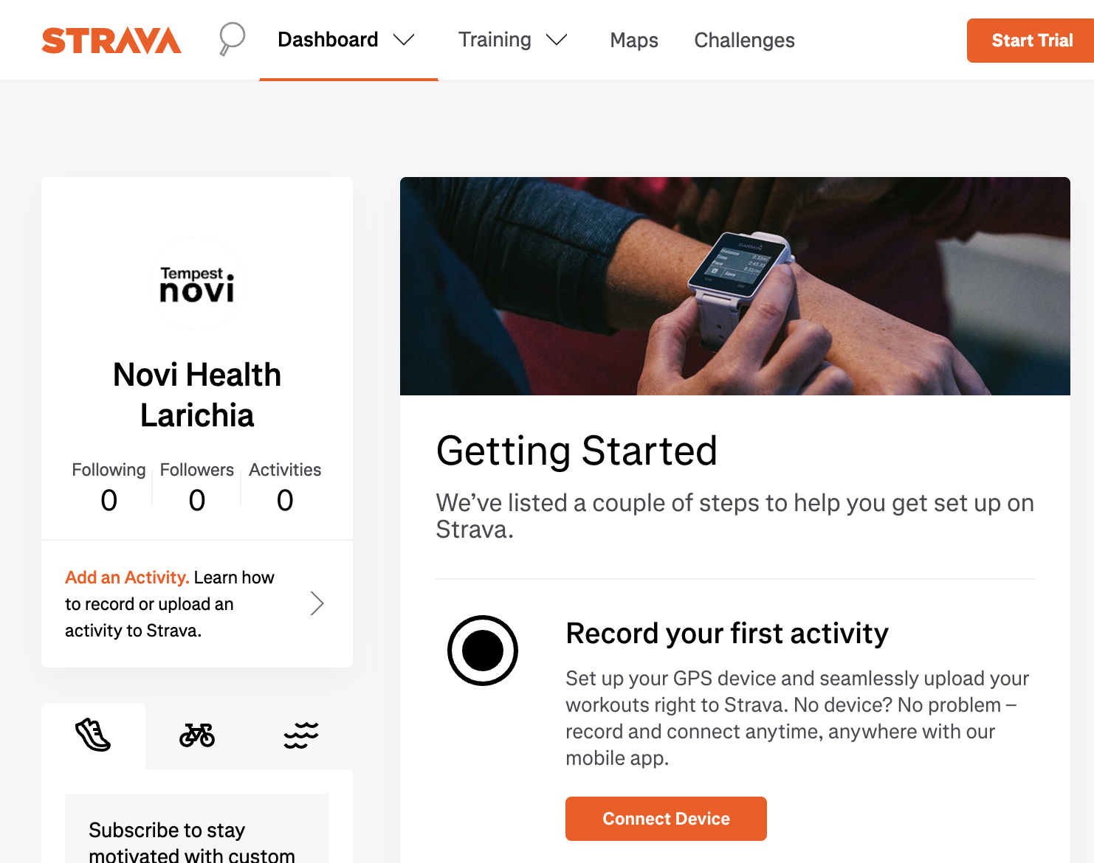
‹#›
The NOVI Experience: Humanising Novi
Community events

Slide 23
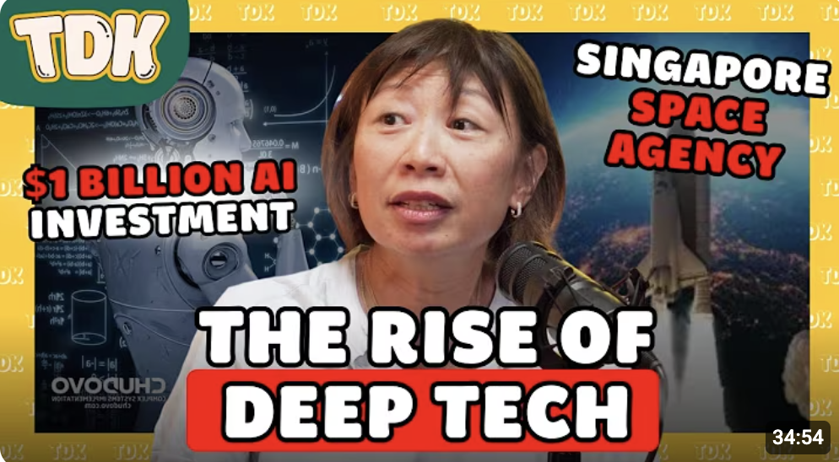
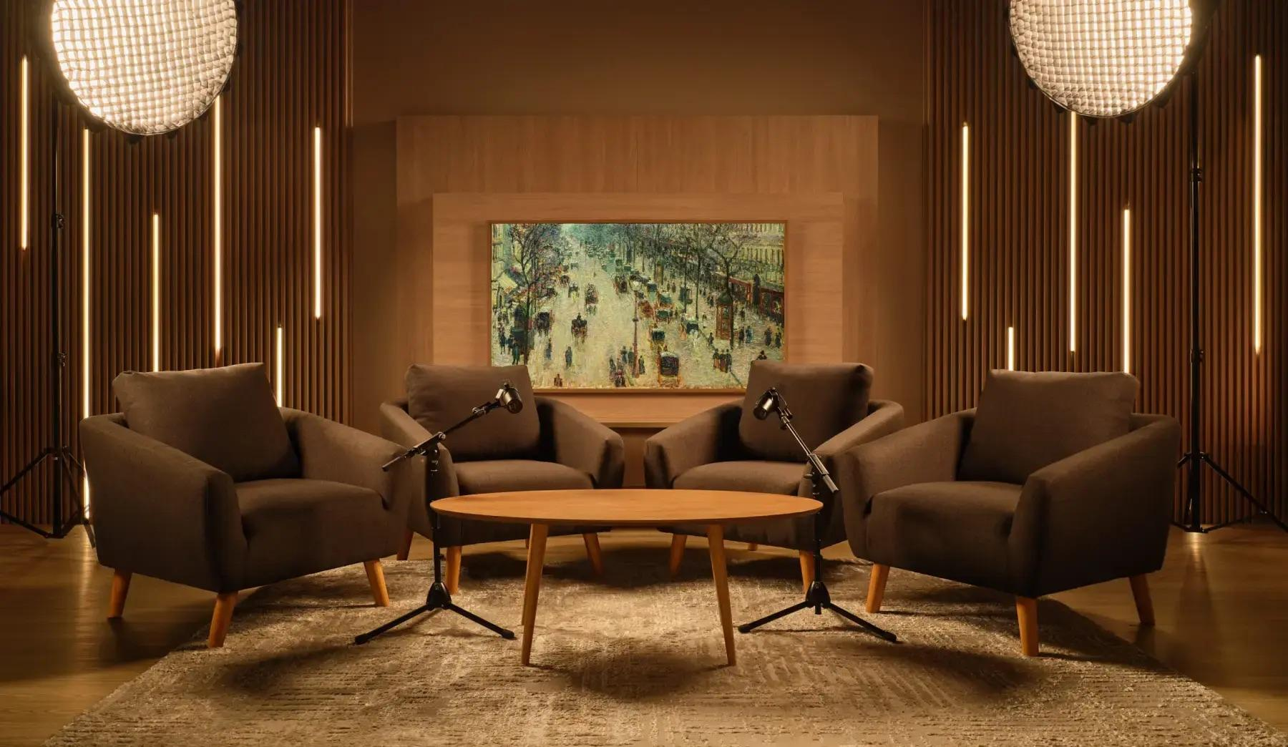
The NOVI Experience: Humanising Novi
‹#›
Podcasts: TDK with DKSH + Novo Nordisk … to follow, Healthspan: By Design
https://www.youtube.com/results?search_query=the+daily+ketchup+podcast
https://singapore.poddster.com/
\

Slide 24


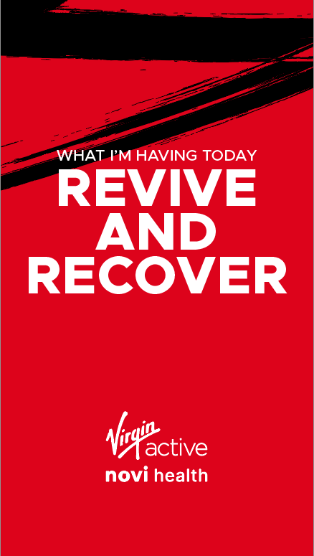


Launch: Partnership: community (launch TBD)
‹#›

Slide 25
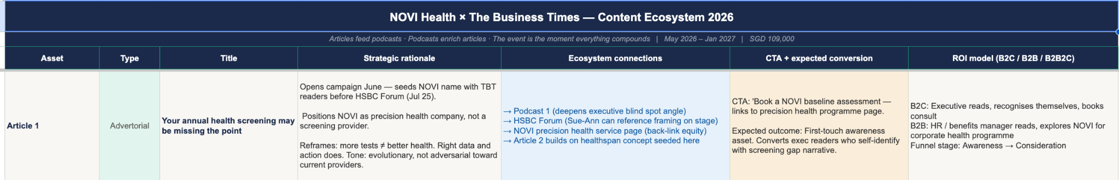
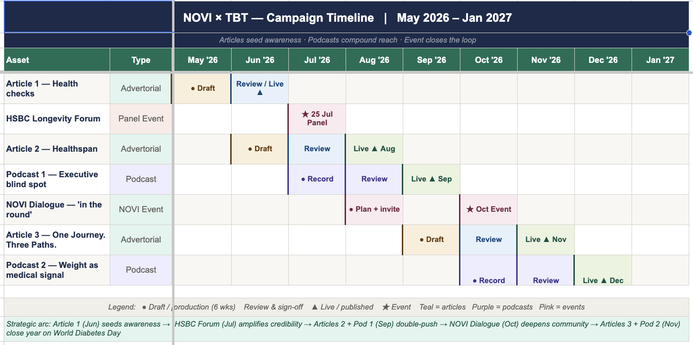
‹#›

Slide 26
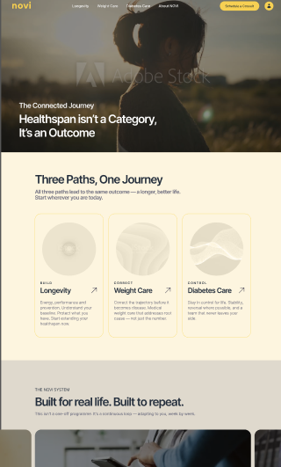
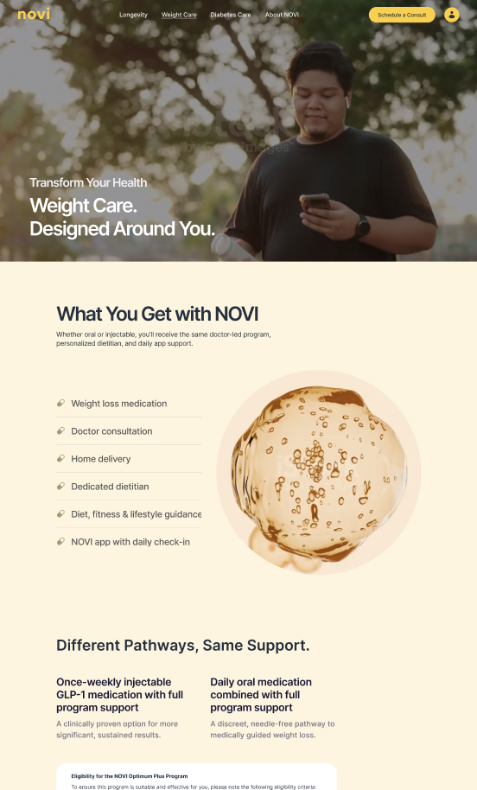
Website: relaunch
‹#›

Slide 27
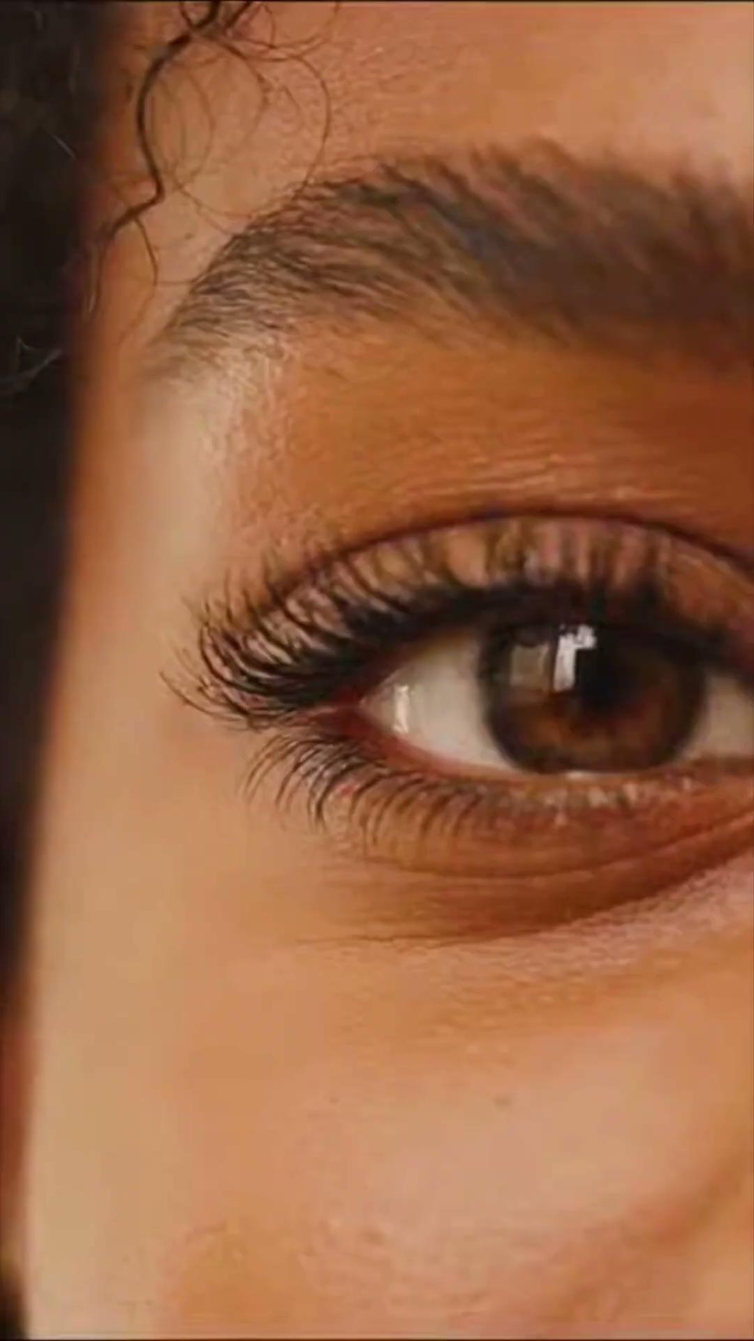
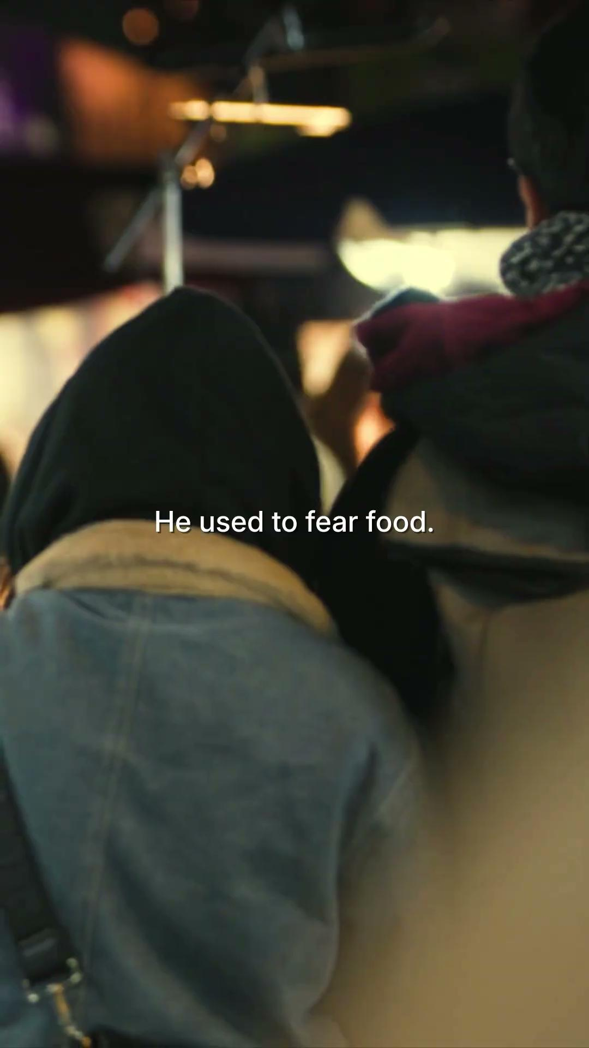
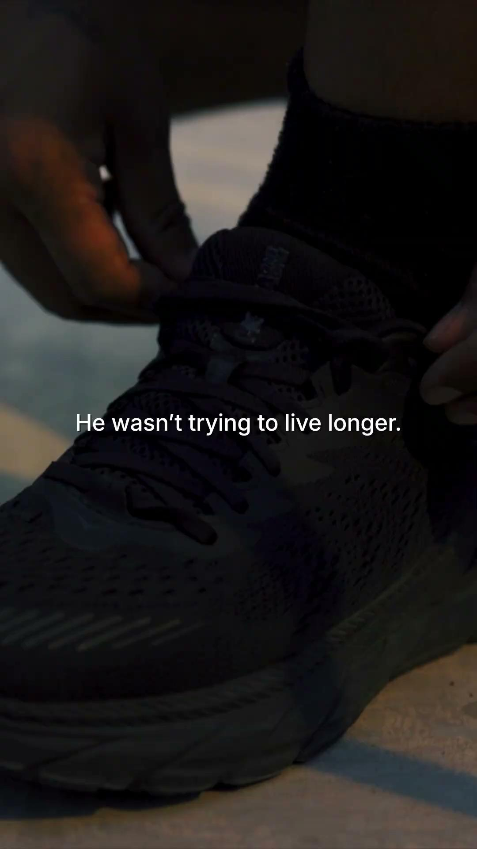
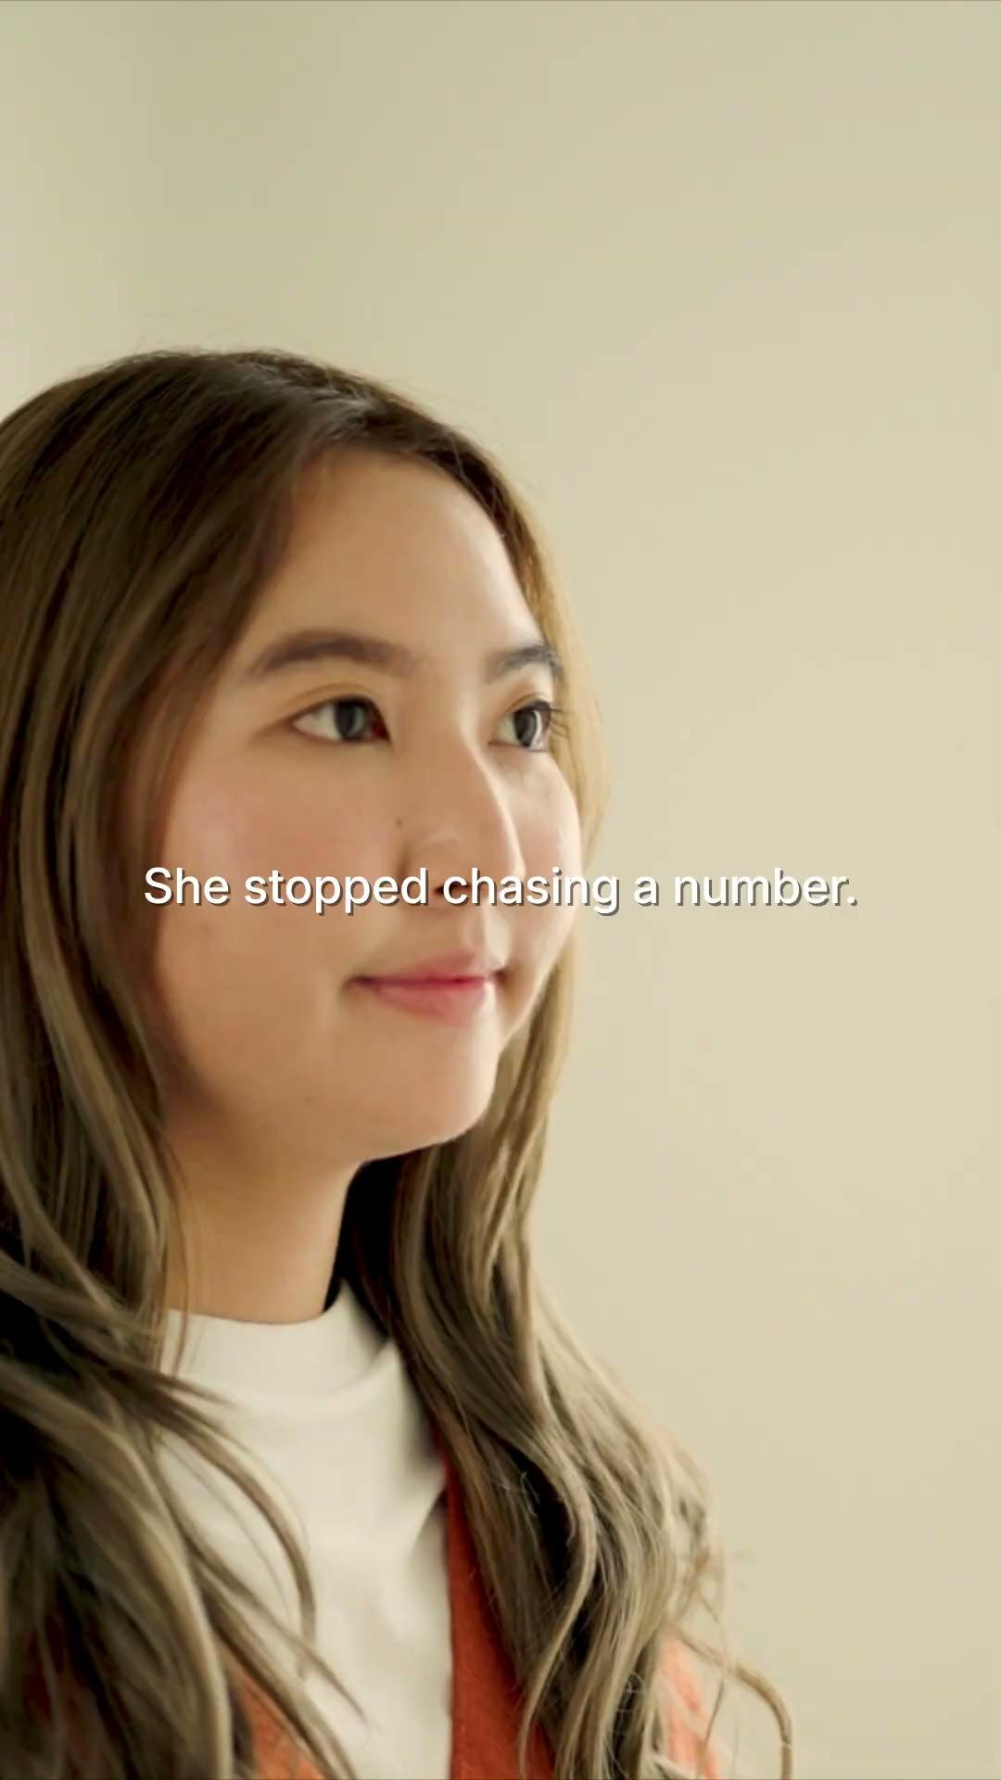
Social: Brand Videos
‹#›
Re-introducing our logo
WMHH: Diabetes Care
WMHH: Longevity
WMHH: Weight Care

Slide 28
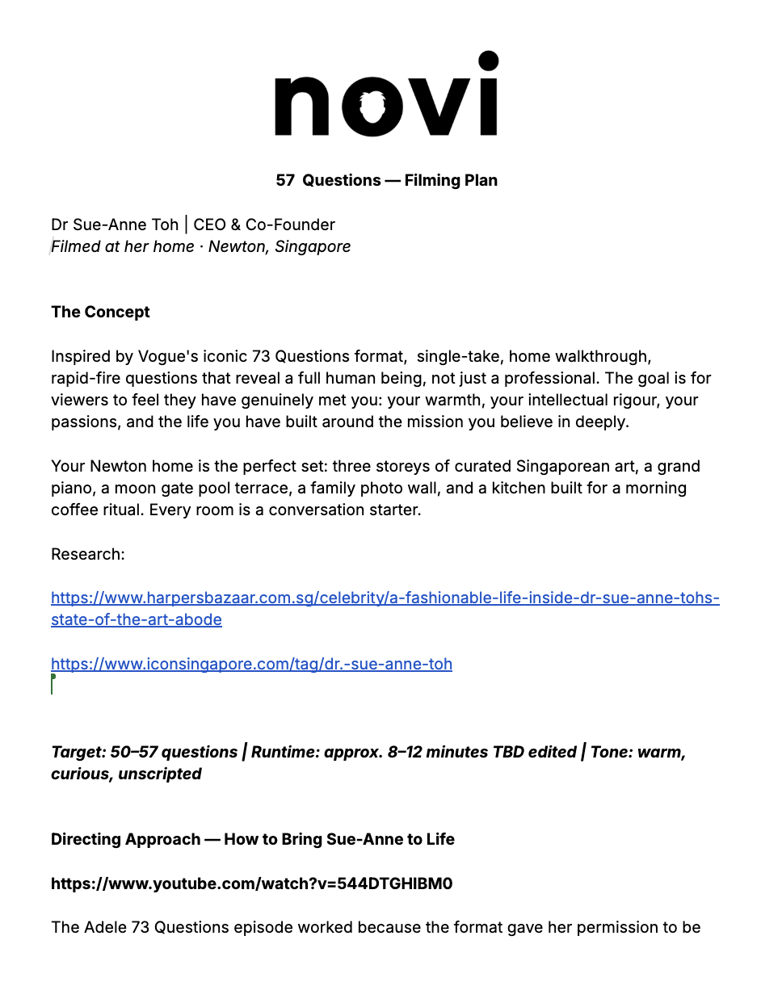
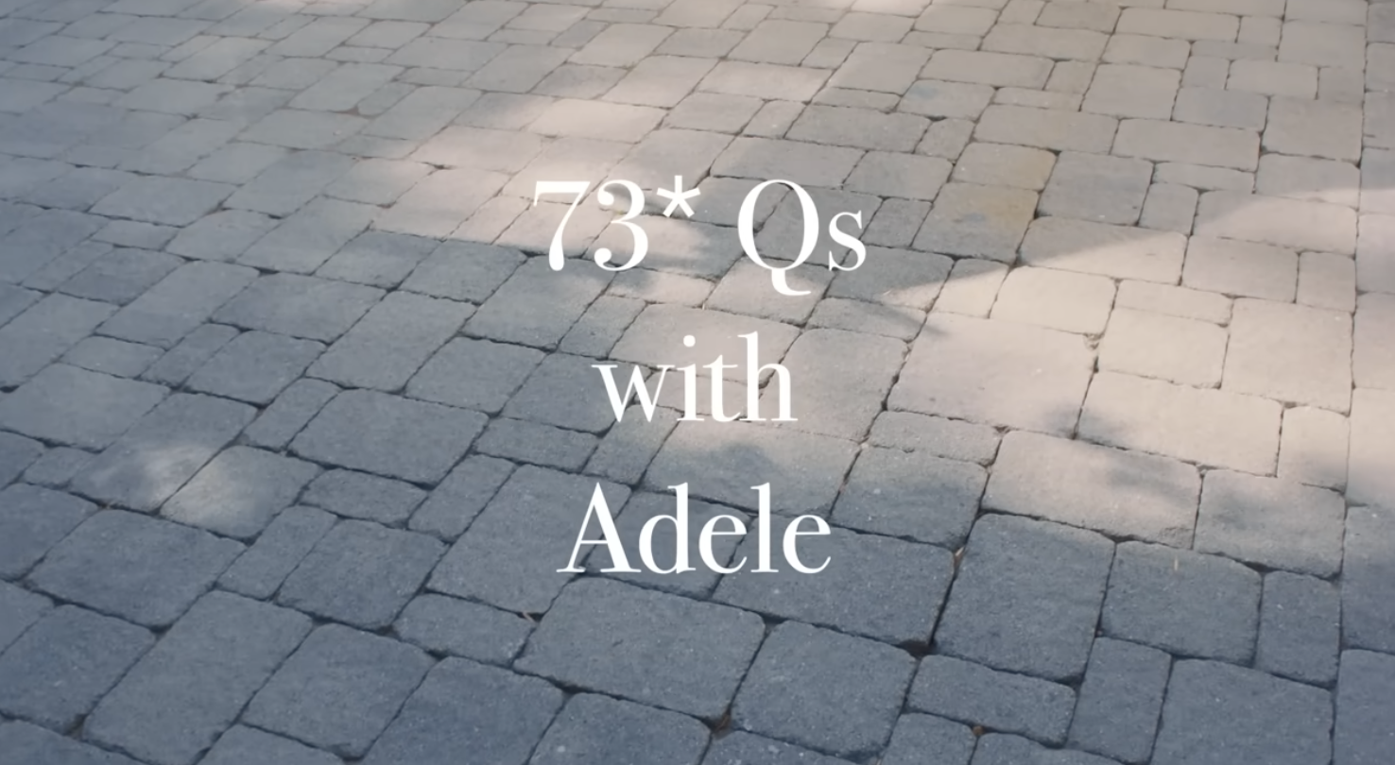
The NOVI Experience: Humanising Novi
‹#›
Sue-Annes 55 Questions
https://docs.google.com/document/d/1Eauvl2UhYvk8j__U_r_hDETQsh4yUCsFUrDtRiUGfLw/edit?tab=t.0
https://www.youtube.com/watch?v=544DTGHIBM0
The Number 5: It corresponds to the "Five Blessings" (Wufu)—longevity, wealth, health, virtue, and a peaceful death. It is also directly linked to the Five Elements (Wu Xing) of wood, fire, earth, metal, and water, which form the foundational principles for balance in traditional Chinese medicine and overall holistic wellness.

Slide 29
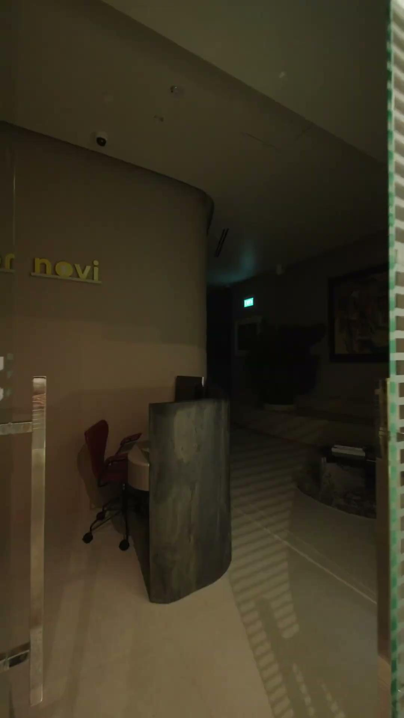
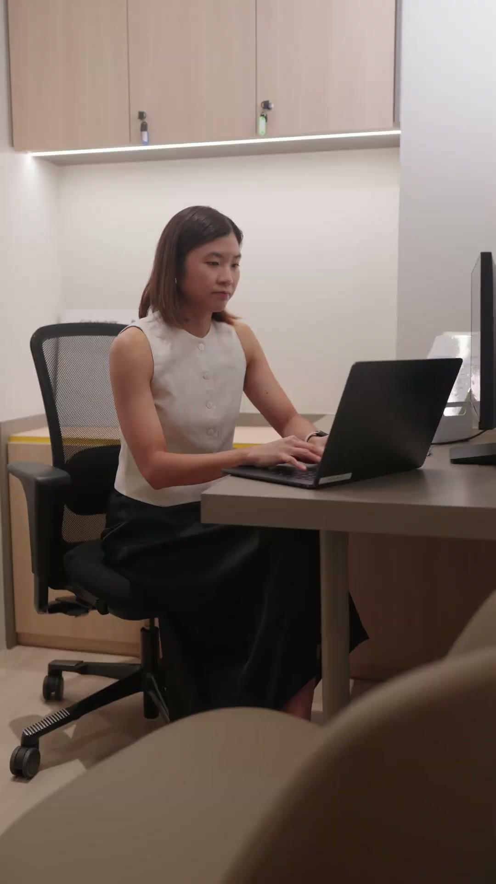
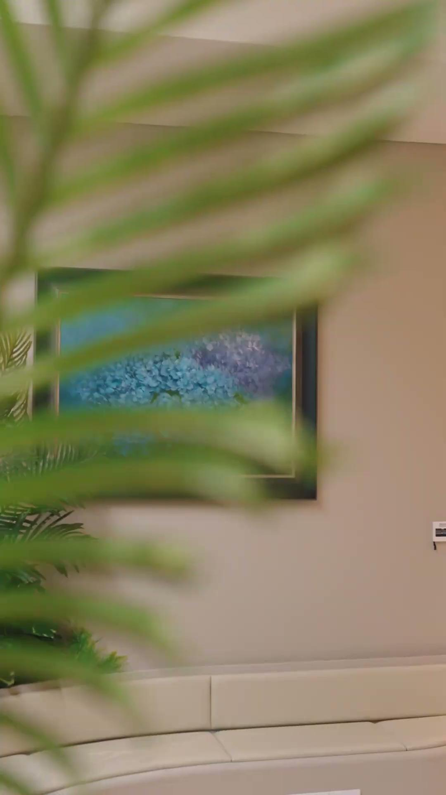
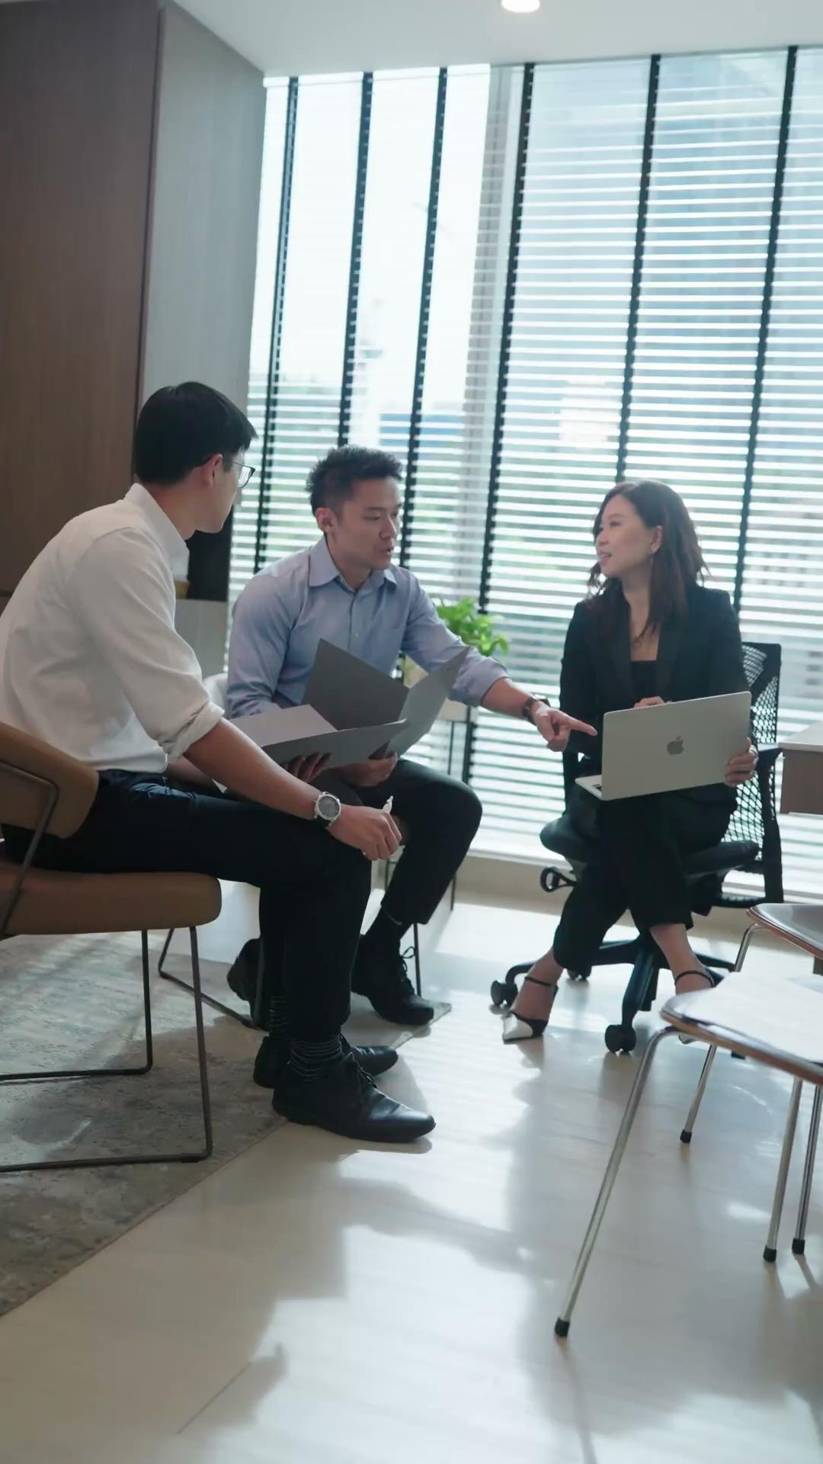
Social: Week By Week Anchor Videos
‹#›
The first 10 Minutes
Coaching
The room matters
Case review

Slide 30
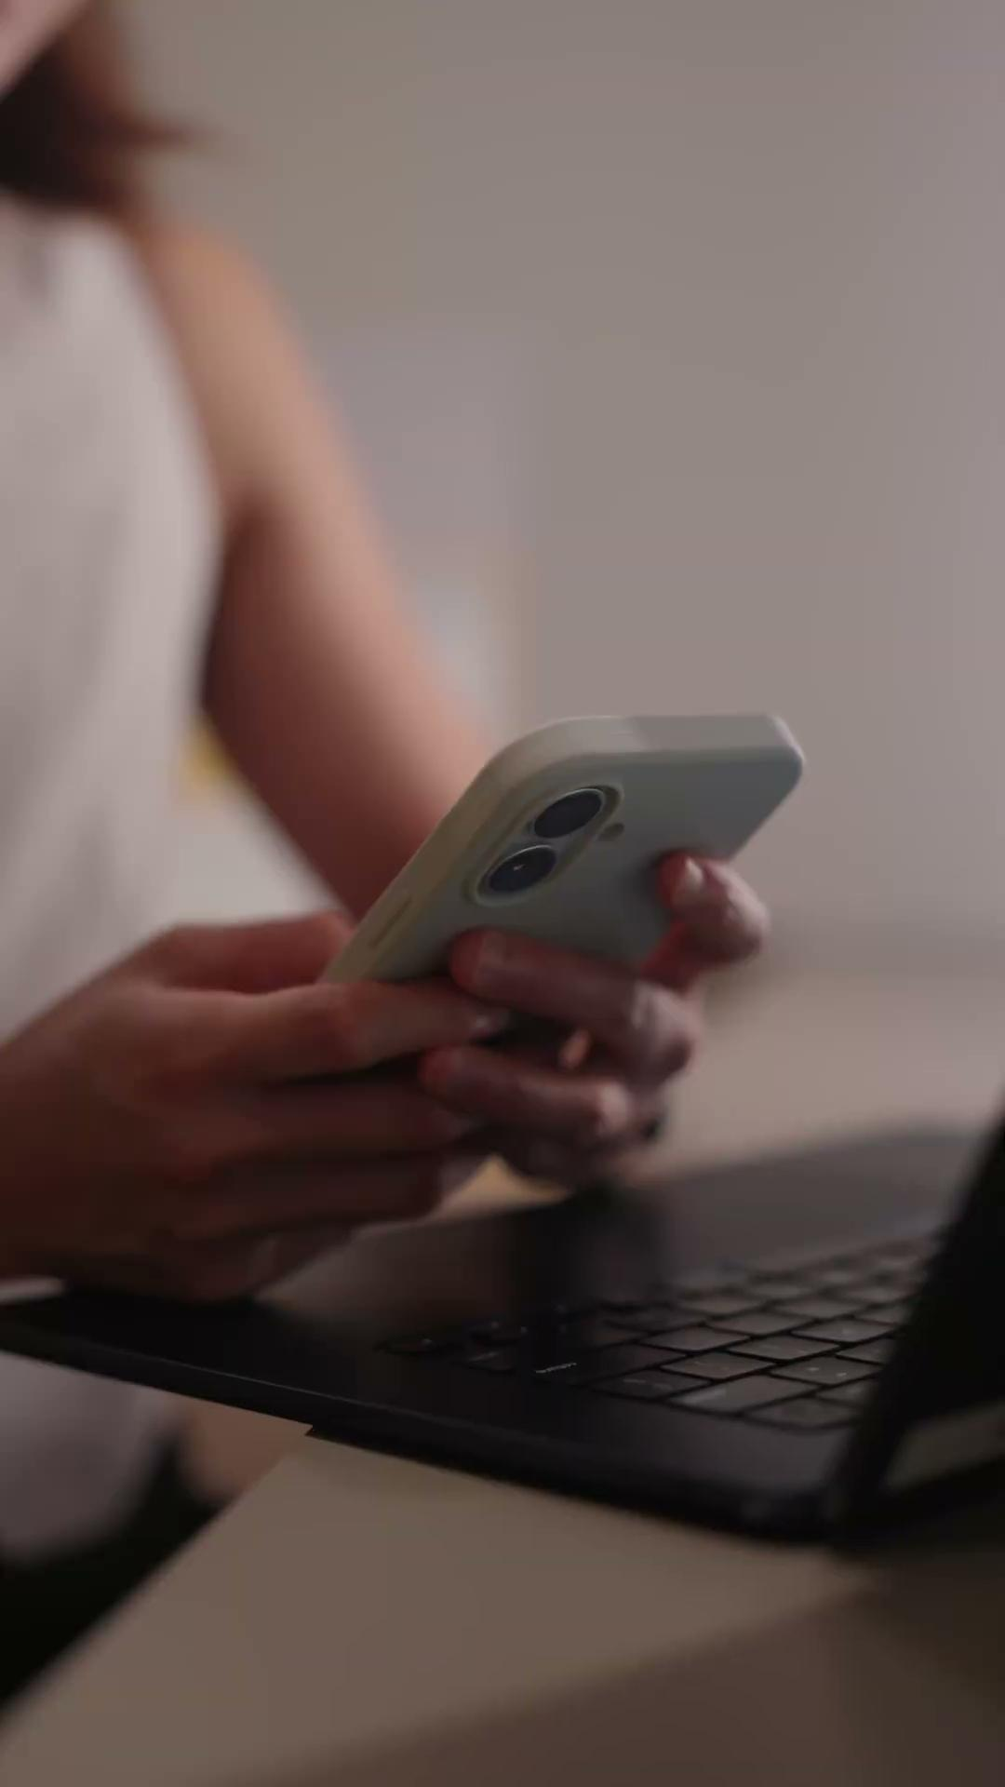
Social: Week By Week Anchor Videos
‹#›
(filming 28:05)
Coming tonight
Coming tonight
Between appointments
Why we built this
Not a moment a system
POV journey

Slide 31

BUILDING TO
Ignite
July 2026 — where 8 weeks of content, community and trust converge into NOVI's biggest commercial moment of the year.
8
2
8
1
5+
1
hero films released
Instagram posts/week
EDM broadcasts
Ask Dr Whitney series
community events
TBT advertorial live

Slide 32
NOVI HEALTH · CAMPAIGN PLAN · MAY–JUNE 2026
From first video
to website launch —
8 weeks.
The plan is built. The assets are coming. Let's move.

Slide 33
NOVI HEALTH
Master Content Calendar
Late June – September 2026
Website
TBT
eDM
LinkedIn
Instagram
WhatsApp
Event
Spotify/YT
Owned content · TBT partnership · Bangkok activation · Community events

Slide 34
June 2026
Anchor: TBT advertorial #1 live · Health screening narrative · Continuous care article published
DATE
CHANNEL / CONTENT
26 Jun
Web
done
Flagship article: Why more health tests don't always mean better health
this week
TBT
done
TBT advertorial #1: Your annual health screening may be missing the point — 5,500 guaranteed pageviews
eDM
done
"Why more tests may not give better answers" — flagship + BT article + NOVI walk info
IG
Carousel: 5 reasons annual health screenings aren't enough
30 Jun
Web
done
Supporting article #1: What is continuous care and why does it matter?
end of month
LI
Diabetes publication post — founders and Michelle · Drive awareness to the study
Event
TBC
Mandala talk

Slide 35
July 2026
Anchor: Mandala Club 9 Jul · Bangkok soft open 10 Jul · VIP 15 Jul · Live 16–19 Jul · Website relaunch last week Jul · TBT advertorial #2 drafting begins
DATE
CHANNEL / CONTENT
1–4 Jul
LI
Save-the-date posts: Mandala talk + NOVI walk
week 1
Web
WIP
Flagship article: Singapore's metabolic health crisis — why prevention needs a new playbook
TBT
TBT advertorial #2 — brief kickoff + drafting begins · 6-week production cycle · Target live: end of August
8–9 Jul
IG
Carousel: What is continuous care?
week 2
Event
Mandala Club: "Will AI actually make you live longer? A doctor and a CTO place their bets" (9 Jul)
Spotify
Sue-Anne video release — Spotify + YouTube
10 Jul
Event
Bangkok
Bangkok pop-up soft open — The Commons Cloud 11 · Brand awareness, no selling, 4 experiential zones
LI
Founder reflections: key takeaways from Mandala event
Bangkok soft open
eDM
Health assessment roundup + Mandala recap + NOVI walk invitation
WAP
Event invite — Mandala talk + NOVI walk
13 Jul
Web
Supporting article #1: What AI can and cannot do in preventive healthcare (drawn from Mandala talk)
week 3
15 Jul
Event
Bangkok
Bangkok VIP opening night — The Commons Cloud 11
Bangkok VIP
16–19 Jul
Event
Bangkok
Bangkok activation fully live — The Commons Cloud 11 · Continues through Wholesome Week 1–9 Aug
Bangkok live
20 Jul
Web
Supporting article #2: Why human coaching still matters in the age of AI
week 4
28–31 Jul
Web
NOVI.health website go-live — new brand positioning, full content + SEO refresh
website relaunch
LI
Doctor perspective: where technology genuinely improves patient outcomes
eDM
"What we learned from asking whether AI can help us live longer" — Mandala recap + nurture
NOVI Health · Master Calendar 2026 · All dates subject to change

Slide 36
August 2026
Anchor: Bangkok Wholesome Week 1–9 Aug · National Day 9 Aug · Healthspan arc · TBT advertorial #2 live end of month
DATE
CHANNEL / CONTENT
1–9 Aug
Event
Bangkok
Bangkok Wholesome Week — The Commons Cloud 11 · Final activation window, closes the Bangkok pop-up run
Wholesome Week
3–5 Aug
Web
Flagship article: Adding healthy years to life — why prevention is moving beyond one-size-fits-all screening
week 1
LI
Founder post: what does it mean to age well in Singapore? (National Day tie-in)
eDM
"How many healthy years can we add to our lives?" — introduces August flagship article
10–13 Aug
Web
done
Supporting article #1: Fruits and sugar — should you be worried about fruit sugar?
week 2
LI
Founder post: why prevention should become more personalised
17–20 Aug
Web
Supporting article #2: Healthspan vs lifespan — why the difference matters (feeds search demand ahead of TBT advertorial #2)
week 3
WAP
"What does it mean to age well in Singapore?" + NOVI walk invitation
eDM
"What we've learned about living better for longer" — August recap and nurture
Late Aug
TBT
TBT
TBT advertorial #2 live: Why Singapore's healthspan matters more than its lifespan · 5,500 guaranteed pageviews · Primes audience for TBT Podcast 1 in September
week 4
NOVI Health · Master Calendar 2026 · All dates subject to change

Slide 37
September 2026
Anchor: TBT Podcast 1 live · Metabolic health playbook · World Heart Day 29 Sep
DATE
CHANNEL / CONTENT
1–3 Sep
Web
Flagship article: Singapore's metabolic health crisis — why prevention needs a new playbook
week 1
TBT
TBT
TBT Podcast 1: The executive health blind spot — why high performers miss early disease · 8,500 plays guaranteed · BT + ST social amplification
LI
Founder post: why metabolic health is becoming everyone's problem
eDM
"Why metabolic health deserves more attention" — introduces September flagship
14–16 Sep
Web
Supporting article #1: Why blood sugar monitoring matters even if you don't have diabetes (high-intent search capture)
weeks 2–3
LI
Doctor perspective: what metabolic health really means
21–23 Sep
Web
Supporting article #2: Why muscle is one of the most important organs for healthy ageing (connects metabolism and longevity)
weeks 3–4
WAP
"Could your metabolism be changing without you noticing?" — re-engage audience
29 Sep
LI
World Heart Day: why heart health begins with metabolic health
World Heart Day
eDM
Taking care of your heart × what we've learned about metabolic health this month — World Heart Day eDM
NOVI Health · Master Calendar 2026 · All dates subject to change

